Slide 1


Spring 2021
SKKU Biostats and Big data
CHOONG-WAN WOO | COCOAN lab | http://cocoanlab.github.io

Slide 2
GBME Probability and Statistics
Lecture 16
Lecture 16
Hypothesis testing for proportions
P-values, what’s the problem?
CHOONG-WAN WOO | COCOAN lab | http://cocoanlab.github.io

Slide 3
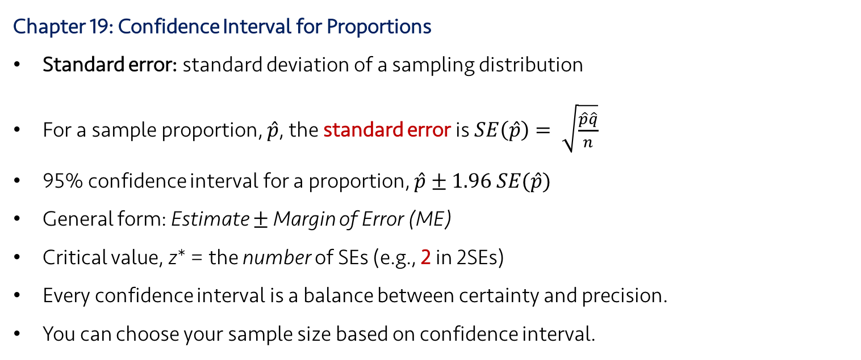
Lecture 16
Review: Key Points
Chapter 19: Confidence Interval for Proportions
Standard error: standard deviation of a sampling distribution
For a sample proportion, $\hat{p}$, the standard error is $SE\left(\hat{p}\right)= \sqrt{\frac{\hat{p}\hat{q}}{n}}$
95% confidence interval for a proportion, $\hat{p}±1.96 SE(\hat{p})$
General form: Estimate $±$ Margin of Error (ME)
Critical value, z* = the number of SEs (e.g., 2 in 2SEs)
Every confidence interval is a balance between certainty and precision.
You can choose your sample size based on confidence interval.
CHOONG-WAN WOO | COCOAN lab | http://cocoanlab.github.io

Slide 4
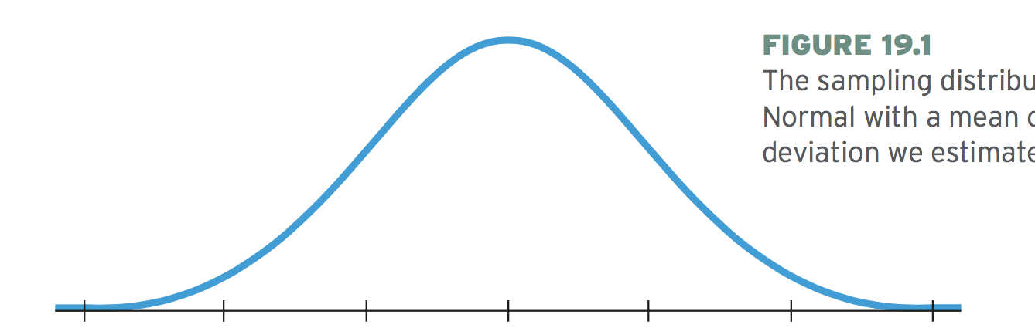
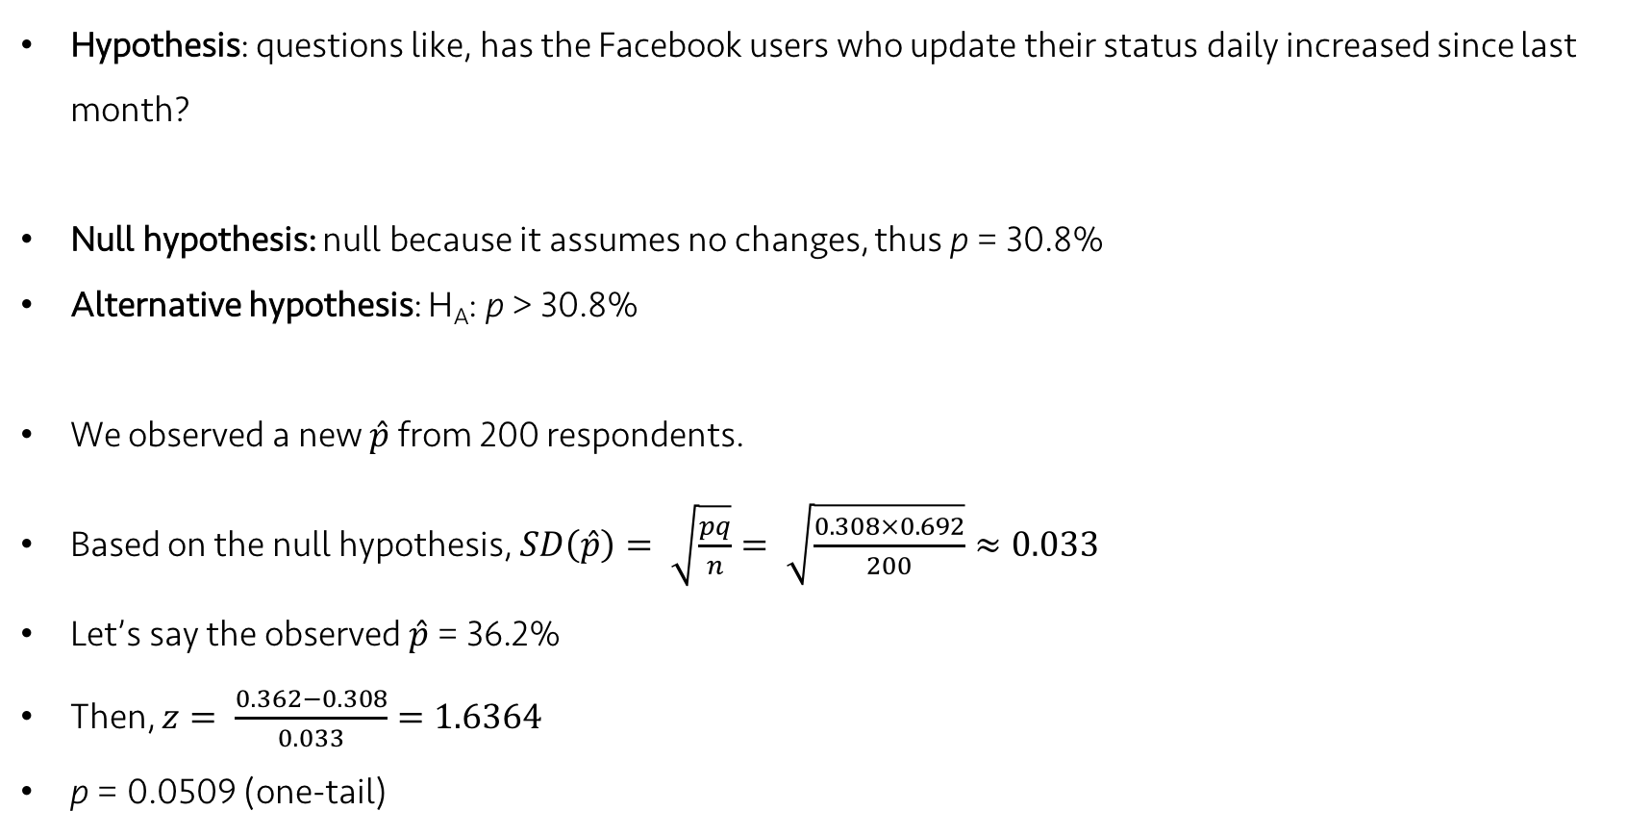
Lecture 16
Hypotheses
Hypothesis: questions like, has the Facebook users who update their status daily increased since last month?
Null hypothesis: null because it assumes no changes, thus p = 30.8%
Alternative hypothesis: H_{A}: p > 30.8%
We observed a new $\hat{p}$ from 200 respondents.
Based on the null hypothesis, $SD\left(\hat{p}\right)= \sqrt{\frac{pq}{n}}= \sqrt{\frac{0.308×0.692}{200}}≈0.033$
Let’s say the observed $\hat{p}$ = 36.2%
Then, $z= \frac{0.362−0.308}{0.033}=1.6364$
p = 0.0509 (one-tail)
0.362
p = 0.0509
0.308
-0.066
0.308
-0.033
0.308
0.308
+0.033
0.308
+0.066
CHOONG-WAN WOO | COCOAN lab | http://cocoanlab.github.io

Slide 5
Lecture 16
A Trial as a “Null Hypothesis Statistical Test” (NHST)
It’s the logic of jury trials.
The null hypothesis is that the defendant is innocent
Judge the evidence
Juries ask “Could these evidence plausibly have happened by chance if the defendant were in fact innocent?”
Make a decision
In hypothesis testing:
We quantify “how surprising the evidence would be if the null hypothesis were true.”
CHOONG-WAN WOO | COCOAN lab | http://cocoanlab.github.io

Slide 6
Lecture 16
P-values
“Are the data surprising given the null hypothesis?”
The probability of seeing the observed data given that the null hypothesis is true: P-value.
P-value is small enough: “we are very surprised”
P-value is high: no surprise, no reason to reject the null hypothesis.
BUT we haven’t proven that the null hypothesis is true. What we can say is that it doesn’t appear to be false.
Formally, we can say: “Fail to reject” the null hypothesis.
Same in a trial
H₀ = innocent defendant
If we fail to reject H₀, the most we can say is the defendant is “not guilty”, rather than the defendant is “innocent”.
What would happen we do the opposite? I.e., H₀: “the defendant is guilty”, then need to prove the defendant is innocent?
CHOONG-WAN WOO | COCOAN lab | http://cocoanlab.github.io

Slide 7
Lecture 16
Quiz 16-1 (3 min)
https://forms.gle/CPcVyon7X6Xbp7qK8
CHOONG-WAN WOO | COCOAN lab | http://cocoanlab.github.io

Slide 8
Lecture 16
Quiz 16-2
https://forms.gle/6zisJaQJh23Bs8r59
CHOONG-WAN WOO | COCOAN lab | http://cocoanlab.github.io

Slide 9
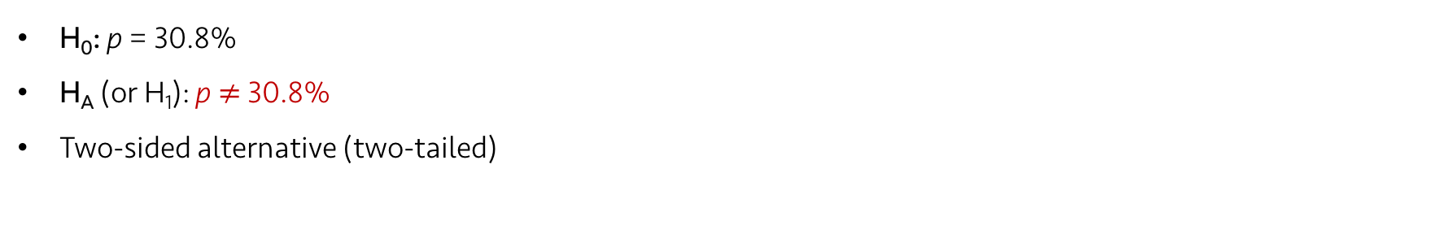
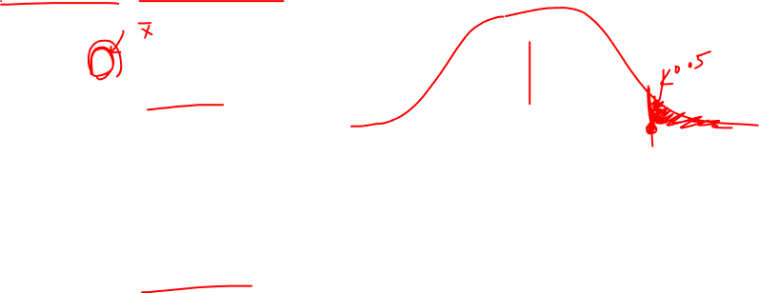
Lecture 16
Two-sided, one-sided alternative
H₀: p = 30.8%
H_{A} (or H₁): p > 30.8%
One-sided alternative (one-tailed)
0.308
-0.066
0.308
-0.033
0.308
0.308
+0.033
0.308
+0.066
H₀: p = 30.8%
H_{A} (or H₁): p $≠$ 30.8%
Two-sided alternative (two-tailed)
0.308
-0.066
0.308
-0.033
0.308
0.308
+0.033
0.308
+0.066
CHOONG-WAN WOO | COCOAN lab | http://cocoanlab.github.io

Slide 10
Lecture 16
P-values and decisions
Hypothesis test is useful when we must make a decision. Guilty or not guilty?
But decision can be often arbitrary. E.g., How small the P-value has to be?
It is highly context-dependent.
When you report your decision about rejecting (or failing to reject) the hypothesis, always provide the p-value, and also confidence interval whenever possible.
CHOONG-WAN WOO | COCOAN lab | http://cocoanlab.github.io

Slide 11
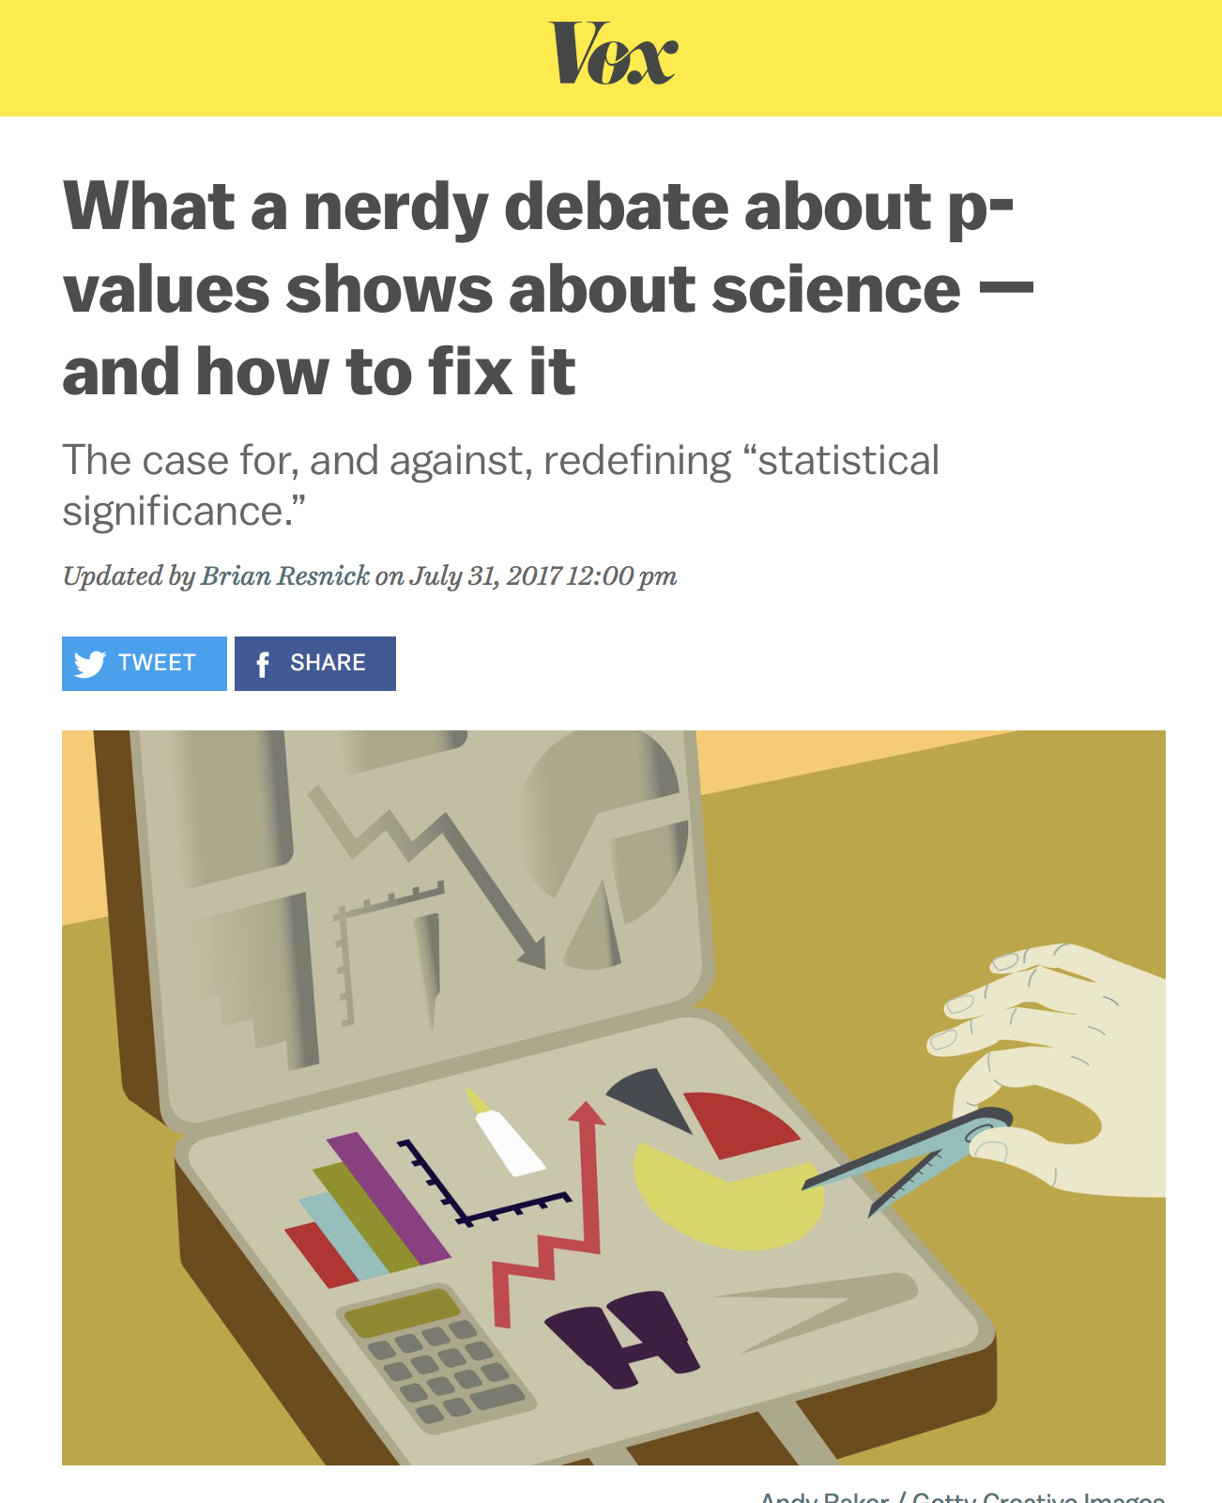
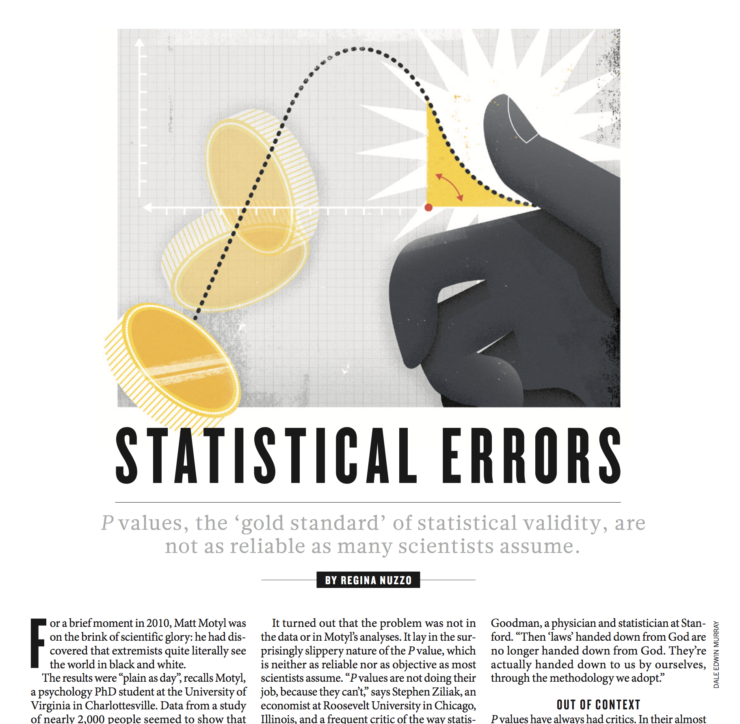
Lecture 16
Recent discussions about p-values
https://www.nature.com/news/scientific-method-statistical-errors-1.14700
https://www.vox.com/platform/amp/science-and-health/2017/7/31/16021654/p-values-statistical-significance-redefine-0005
CHOONG-WAN WOO | COCOAN lab | http://cocoanlab.github.io

Slide 12
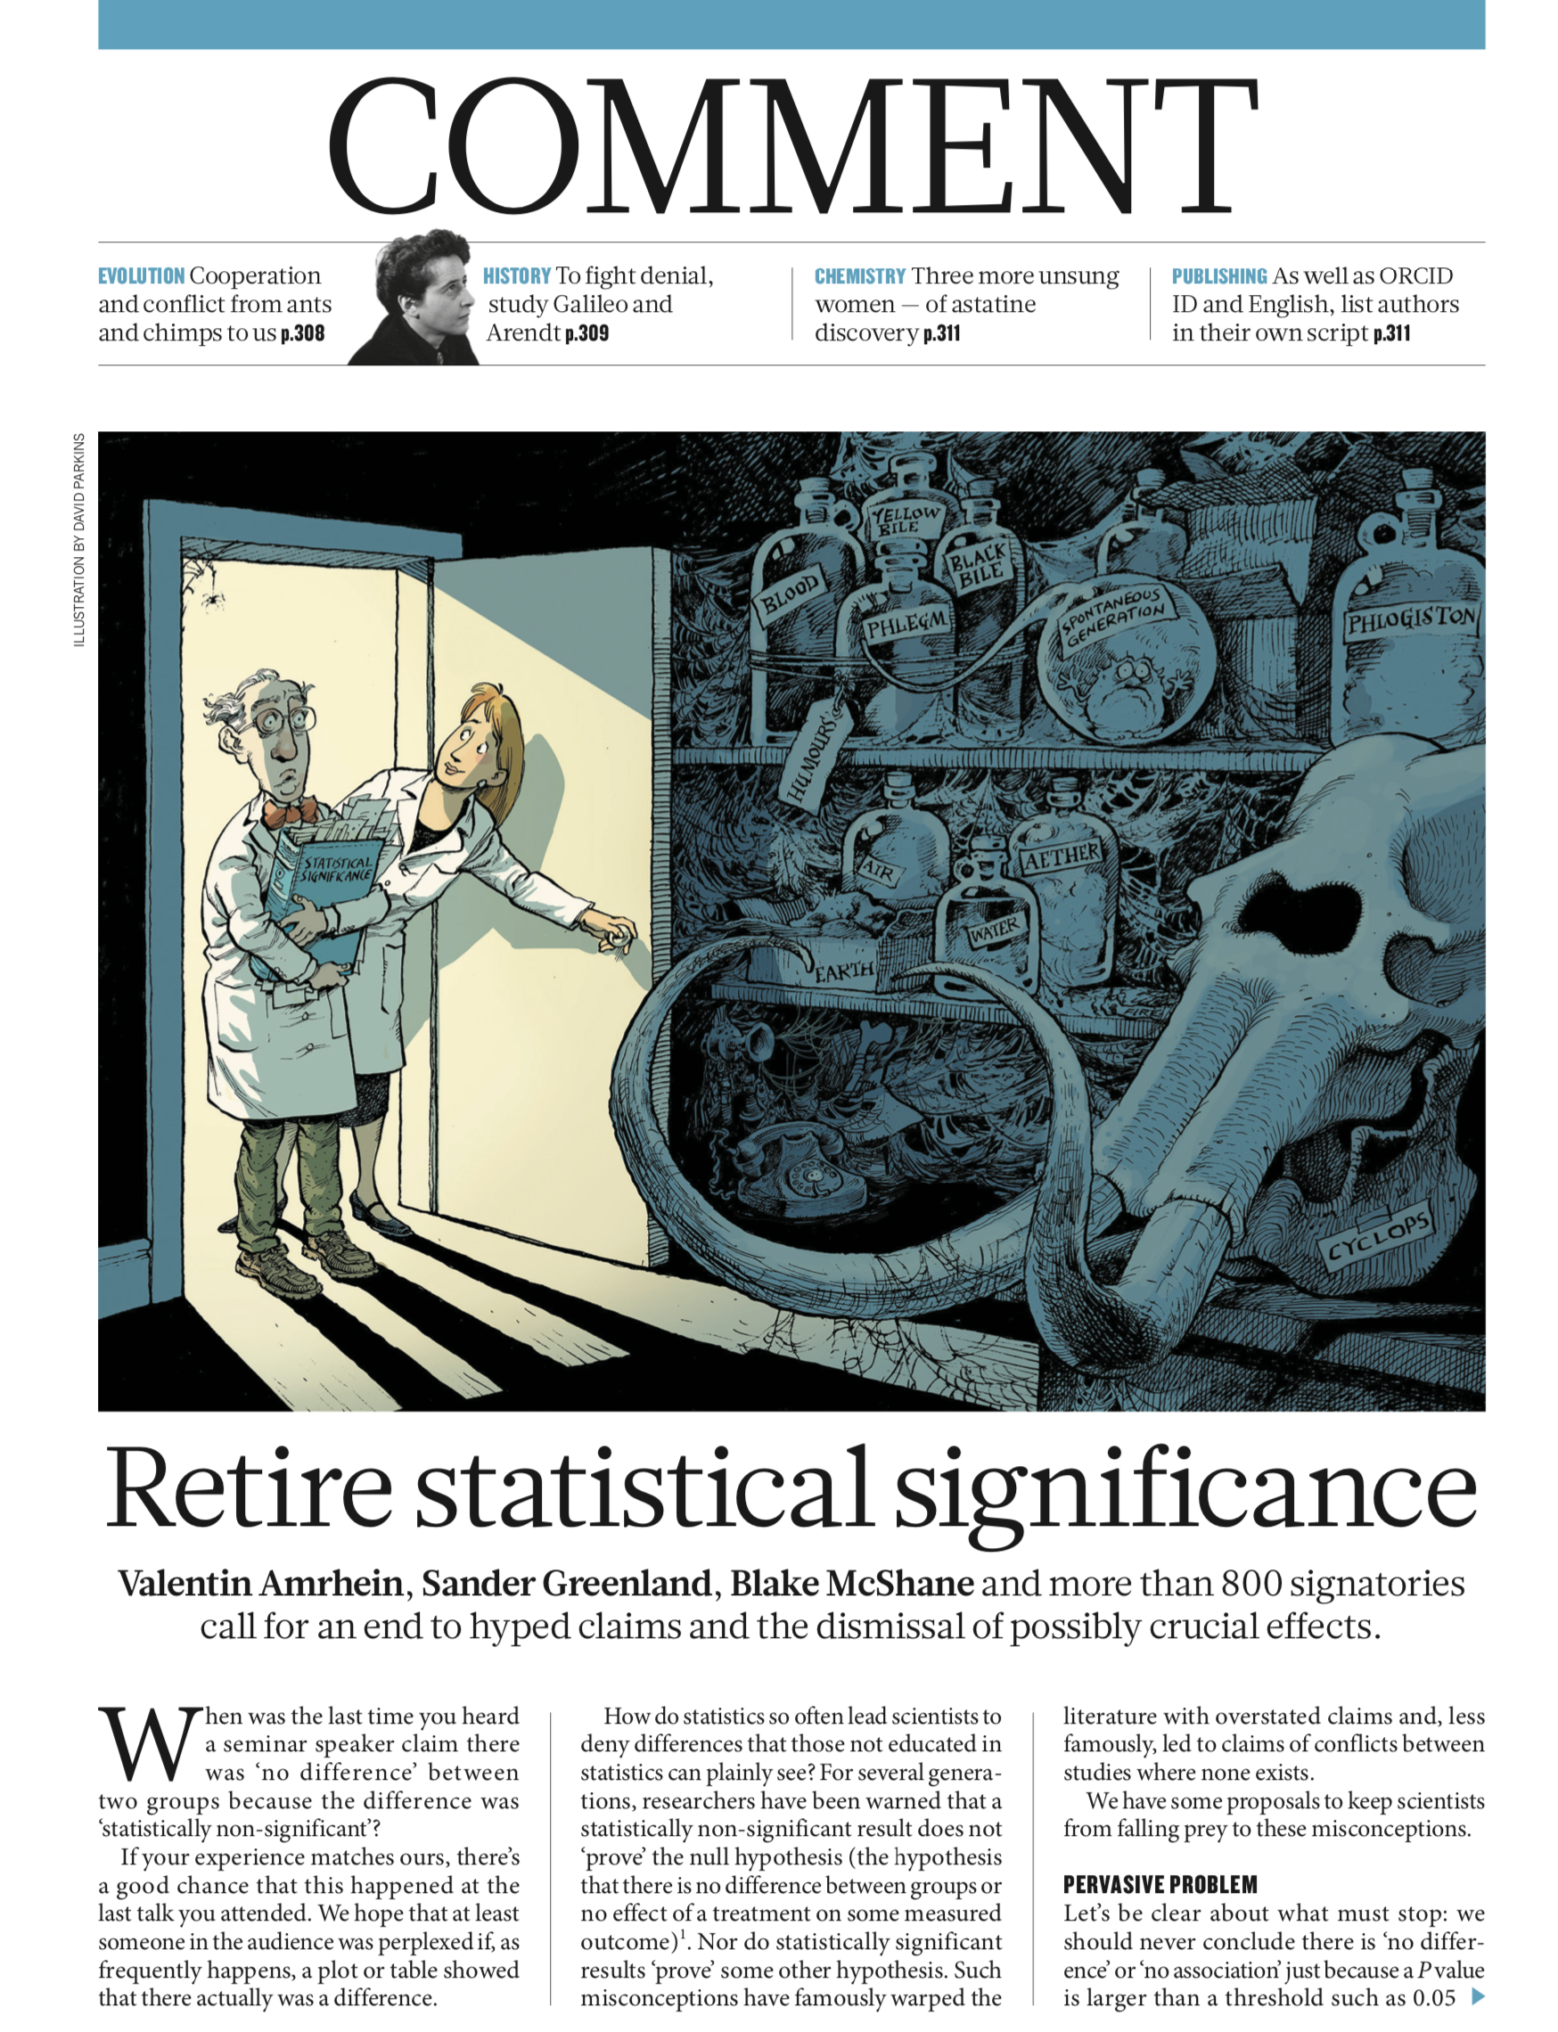
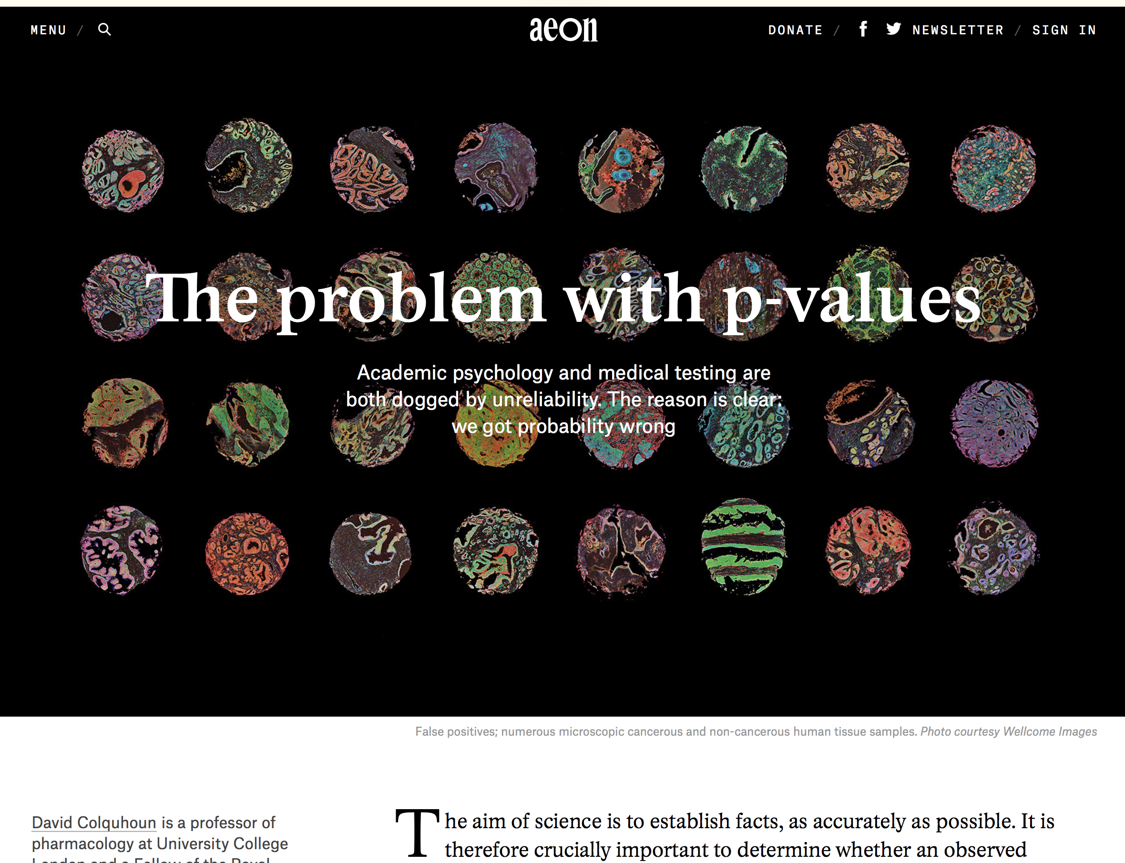
Lecture 07
Recent discussions about p-values
https://aeon.co/essays/it-s-time-for-science-to-abandon-the-term-statistically-significant
https://www.nature.com/articles/d41586-019-00857-9
CHOONG-WAN WOO | COCOAN lab | http://cocoanlab.github.io

Slide 13
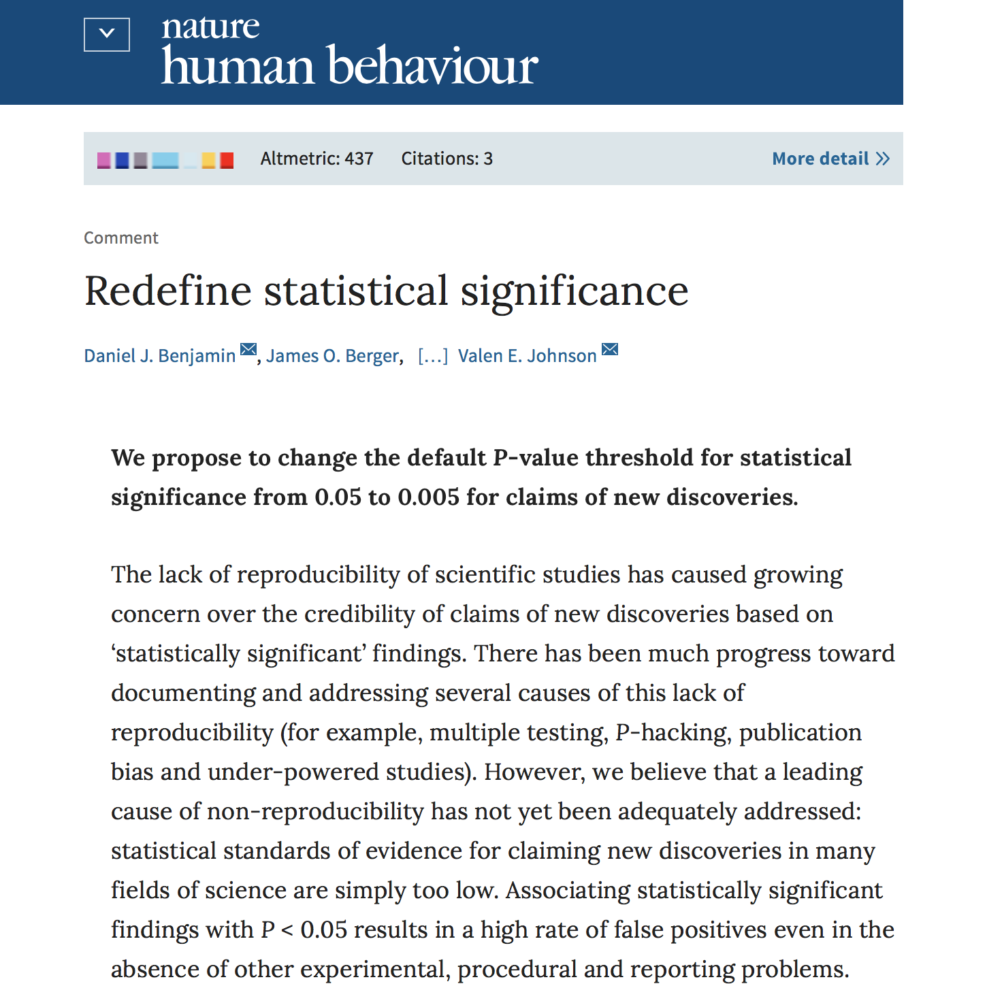
Lecture 16
Recent discussions about p-values
https://www.nature.com/articles/s41562-017-0189-z
CHOONG-WAN WOO | COCOAN lab | http://cocoanlab.github.io

Slide 14
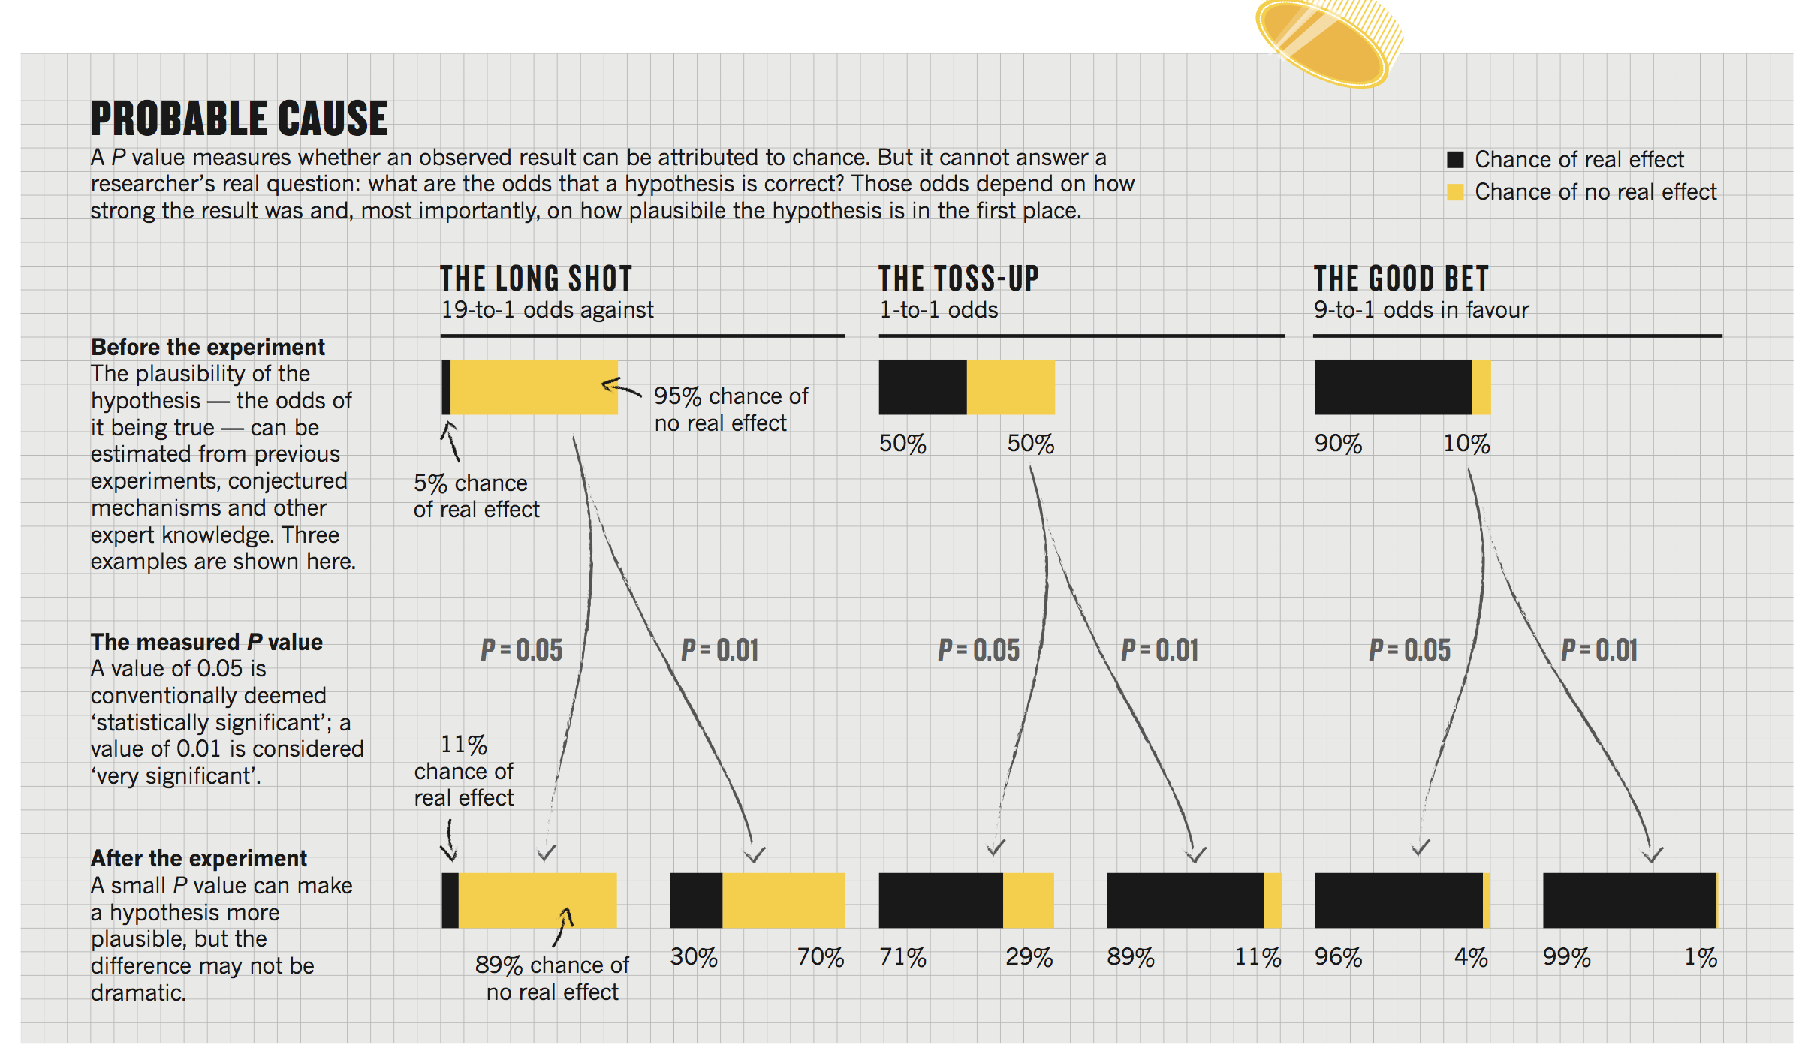
Lecture 16
“Small P value can make a hypothesis more plausible,
but the difference may not be dramatic.”
CHOONG-WAN WOO | COCOAN lab | http://cocoanlab.github.io

Slide 15
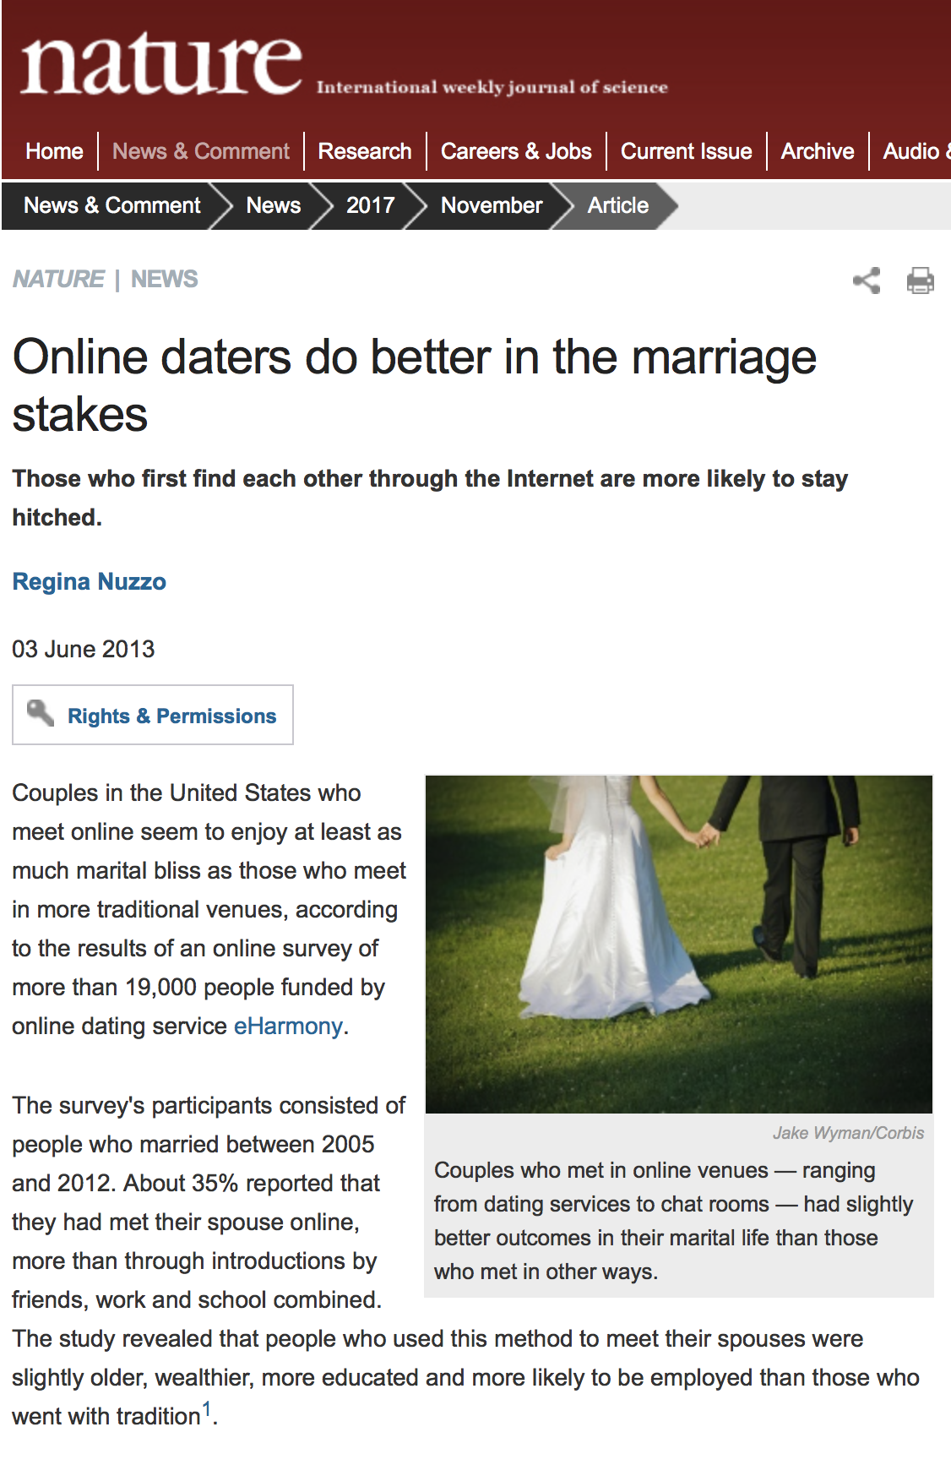
Lecture 16
“How much of an effect is there?”
Study of more than 19,000 people
Those who meet their spouses online are less likely to divorce (p < 0.002) and more likely to have high marital satisfaction (p < 0.001) than those who meet offline.
The divorce rate from 7.67% down to 5.96%; Happiness score from 5.48 to 5.64 on a 7-point scale
“Seductive certainty of significance”
CHOONG-WAN WOO | COCOAN lab | http://cocoanlab.github.io

Slide 16
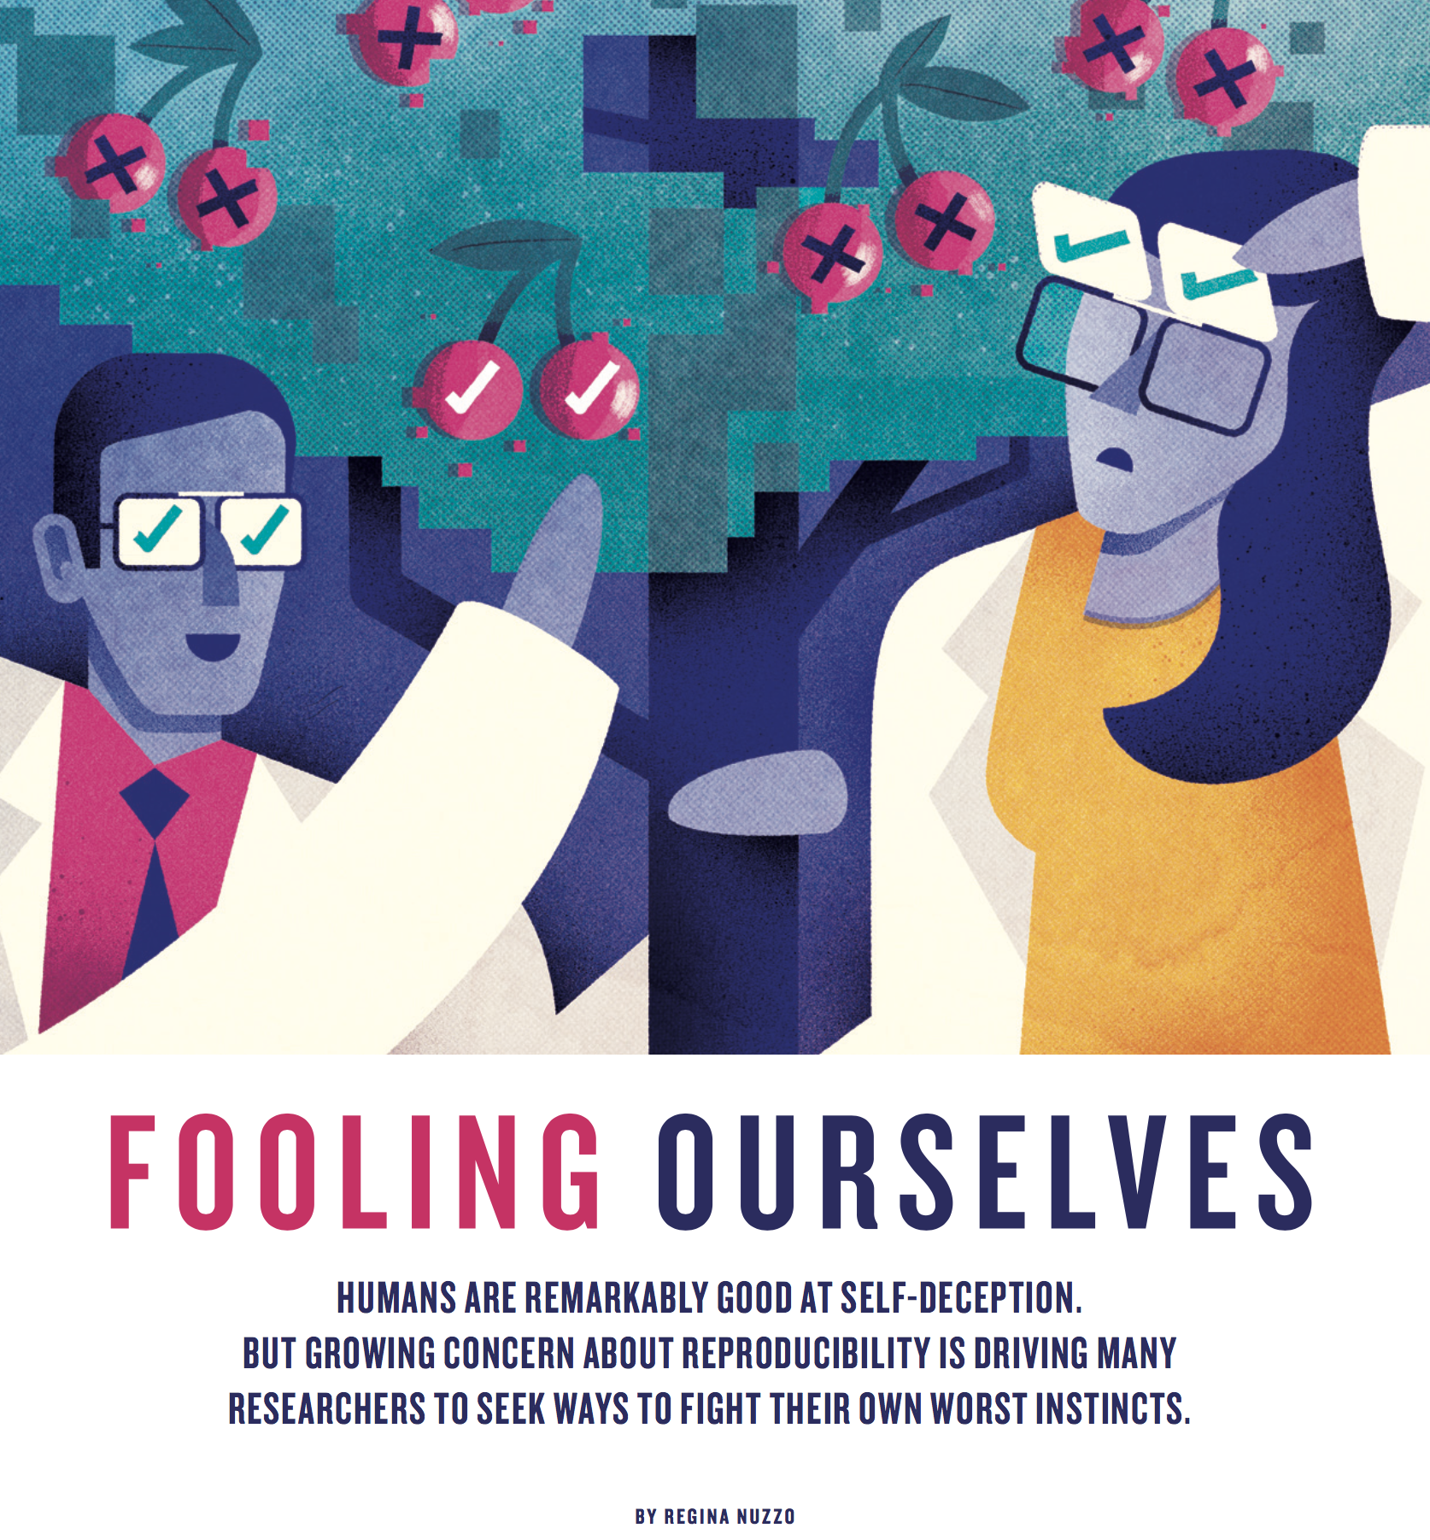
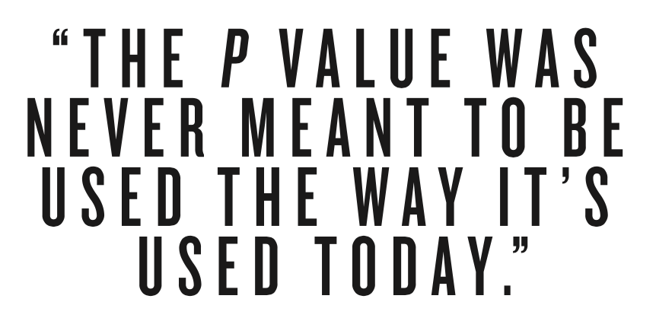
Lecture 16
“P-hacking”
https://www.nature.com/polopoly_fs/1.18517!/menu/main/topColumns/topLeftColumn/pdf/526182a.pdf
CHOONG-WAN WOO | COCOAN lab | http://cocoanlab.github.io

Slide 17
Lecture 16
“P-hacking”
https://www.nature.com/polopoly_fs/1.18517!/menu/main/topColumns/topLeftColumn/pdf/526182a.pdf
CHOONG-WAN WOO | COCOAN lab | http://cocoanlab.github.io

Slide 18
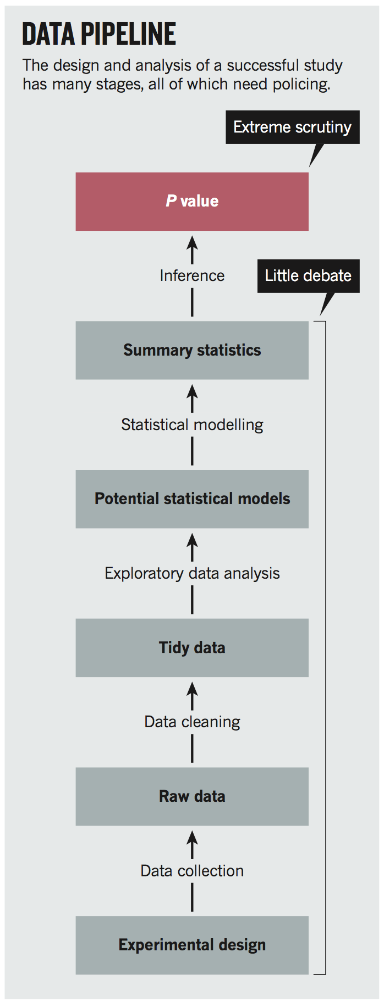
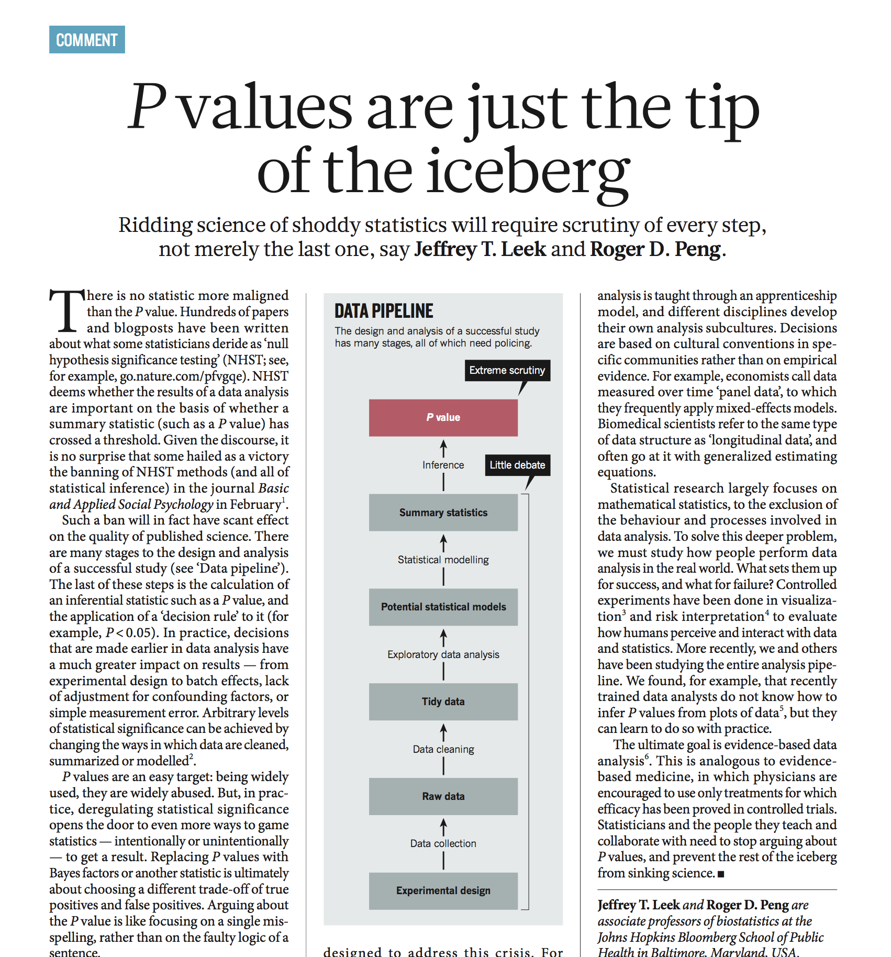
Lecture 16
http://www.nature.com/news/statistics-p-values-are-just-the-tip-of-the-iceberg-1.17412
CHOONG-WAN WOO | COCOAN lab | http://cocoanlab.github.io

Slide 19

Lecture 16
Special section in Nature
on “irreproducible research”
http://www.nature.com/news/reproducibility-1.17552
CHOONG-WAN WOO | COCOAN lab | http://cocoanlab.github.io

Slide 20
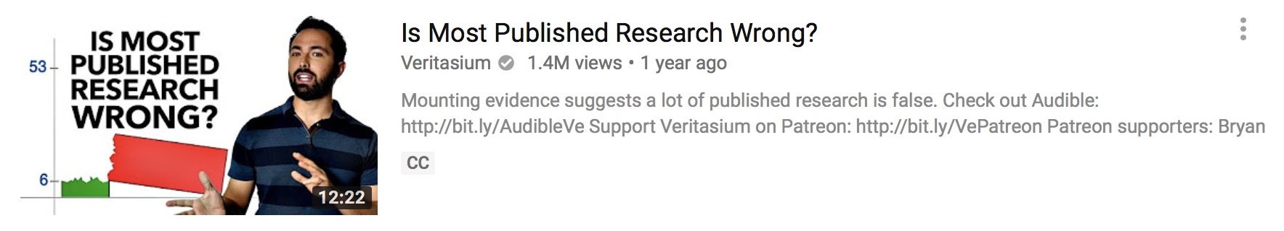
Lecture 16
Good Youtube video on this topic
https://www.youtube.com/watch?v=42QuXLucH3Q
CHOONG-WAN WOO | COCOAN lab | http://cocoanlab.github.io

Slide 21
Lecture 16
Quiz 16-3
https://forms.gle/ddwBrLsqpfoRaHkp6
CHOONG-WAN WOO | COCOAN lab | http://cocoanlab.github.io

Slide 22
Lecture 16
Key Points
Chapter 20: Testing Hypotheses About Proportions
Hypothesis testing: the logic of jury trial
P-value: the probability of seeing the observed data given that the null hypothesis is true.
P-value is for decision-making, but it should not be blinded. It’s context-dependent.
Many issues related to P-values: “Small P value can make a hypothesis more plausible, but the difference may not be dramatic.”
Problems in misuses of P-value are just the tip of the iceberg.
Let’s not fool ourselves!
CHOONG-WAN WOO | COCOAN lab | http://cocoanlab.github.io

